Slide 1
Planet imagery and land cover
March 7, 2019

Slide 2
Using Planet-derived validation data to answer questions:
Land use validation
What’s the SC vs DC classification accuracy for different soymaps?
What’s the soy vs nonsoy agri classification accuracy for different soymaps?
What is the agri vs natural classification accuracy for different soymaps?
(two soymaps to compare so far: Jake’s + Jake’s with pooled years)
Crop timing validation
Do I need to adjust crop timing estimation method?
What error to assign to crop timing maps?
 | Jake’s soymap | Soymap 1 | Soymap 2 (later)
Training points | Soy_pts_agsat_1 (MT only) | Soy_pts_agsat_1 (MT only), masked with map3 agri | Soy_pts_agsat_1 (MT only), masked with map3 agri PLUS PLOS pts (MT only)
Year pooling | Each year has separate trained classifier | 2004-2017 points are pooled and are applied to 2004 – 2018; 2003 is trained and applied by itself
Input data | MODIS, Landsat | Same as Jake’s soymap
GEE file: LandCover/Planet Do Validation

Slide 3
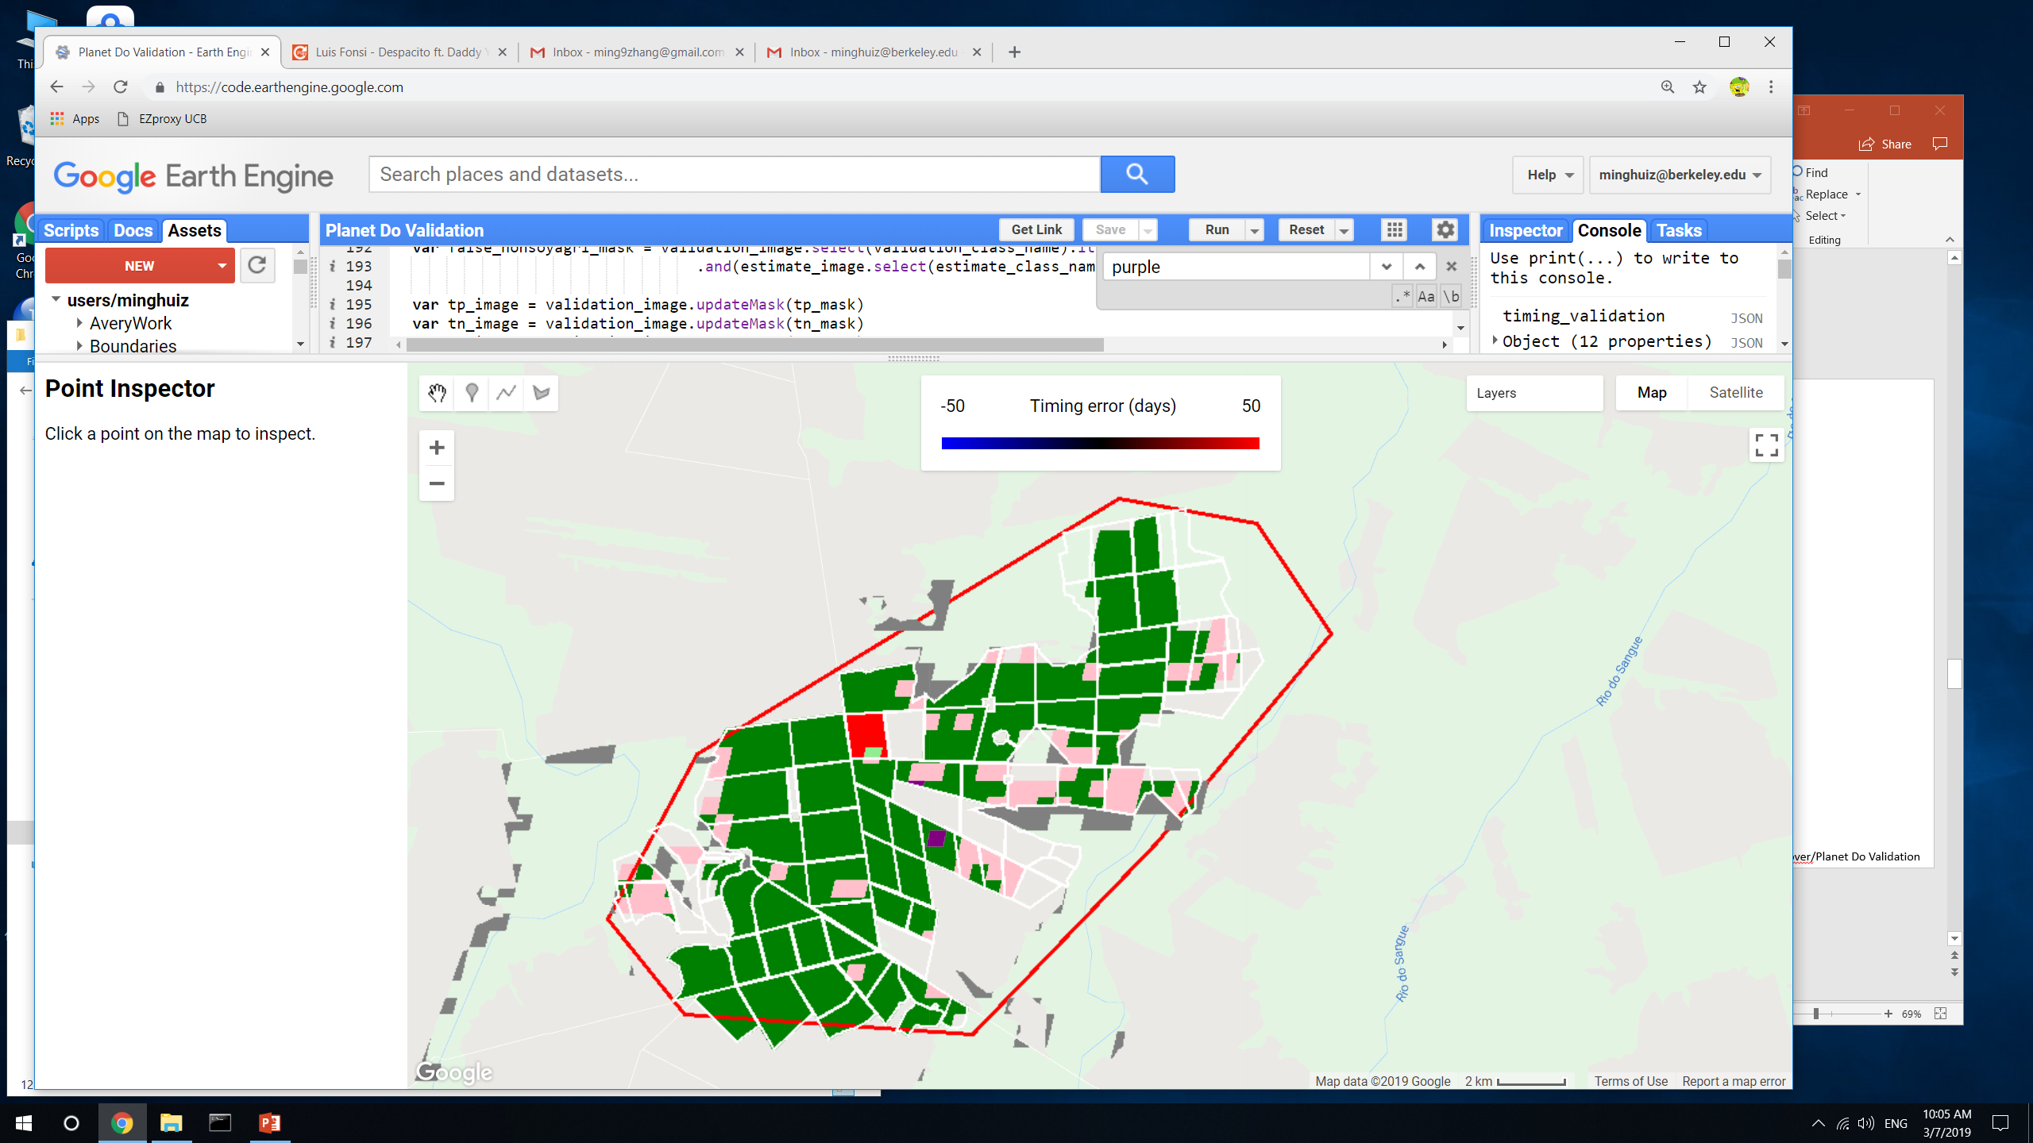
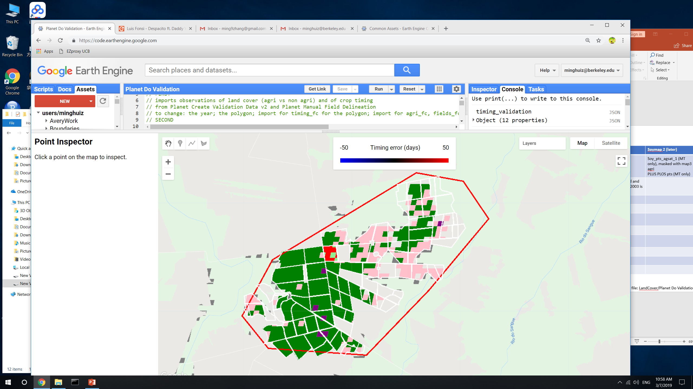
Land classification accuracy for poly5 (MT)
Legend:
True SC = light green
True DC = green
False SC = pink
False DC = red
False nonsoy agri = purple
False agri (actually natural) = gray
All fields except one (the red one) are DC or TC
This region has a lot of soy training points (it was chosen for its soy training point density)
Soymap 1
Jake’s soymap
GEE file: LandCover/Planet Do Validation

Slide 4
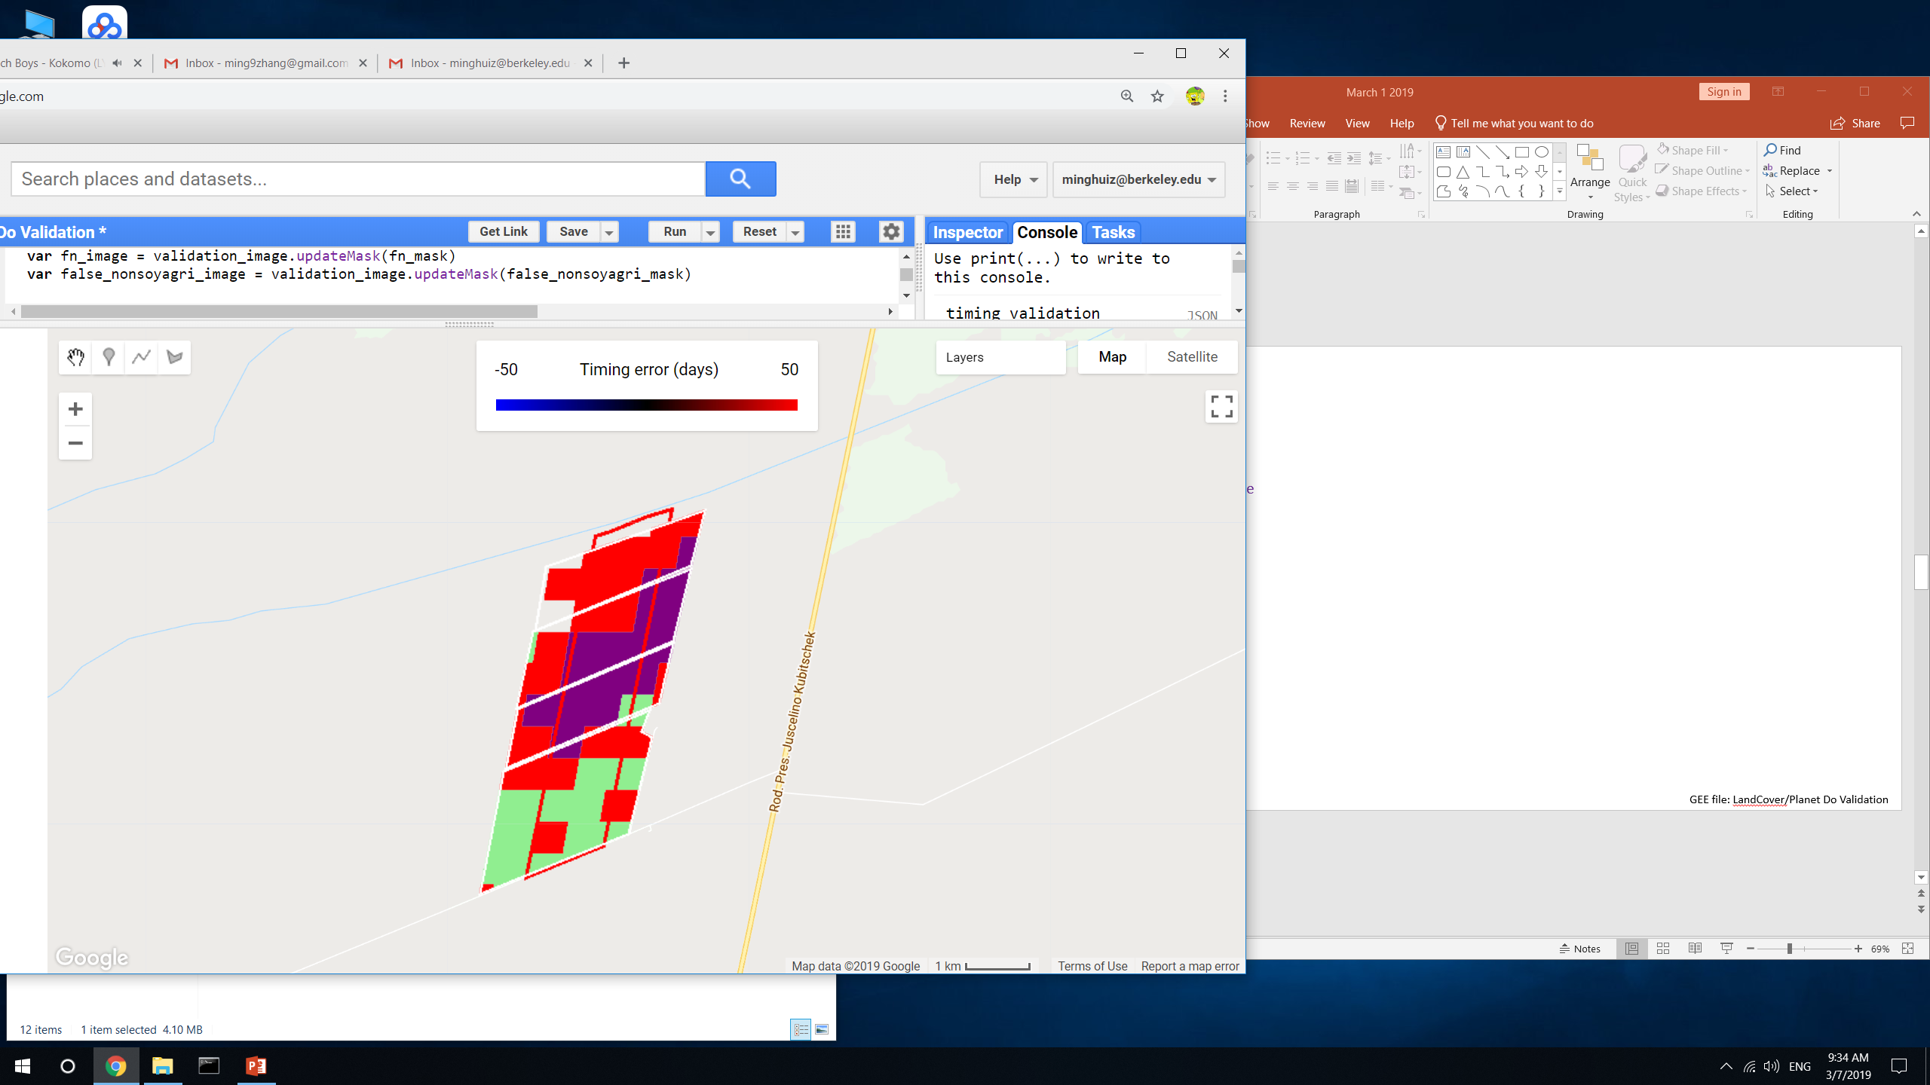
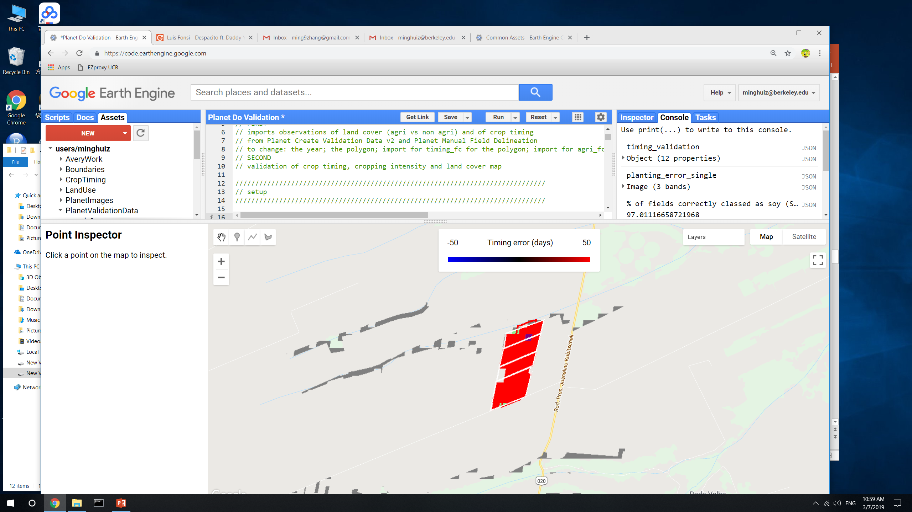
Land classification accuracy for poly3 (Bahia)
Legend:
True SC = light green
True DC = green
False SC = pink
False DC = red
False nonsoy agri = purple
False agri (actually natural) = gray
All fields are SC
This region has no soy training points
Soymap 1
Jake’s soymap
GEE file: LandCover/Planet Do Validation

Slide 5
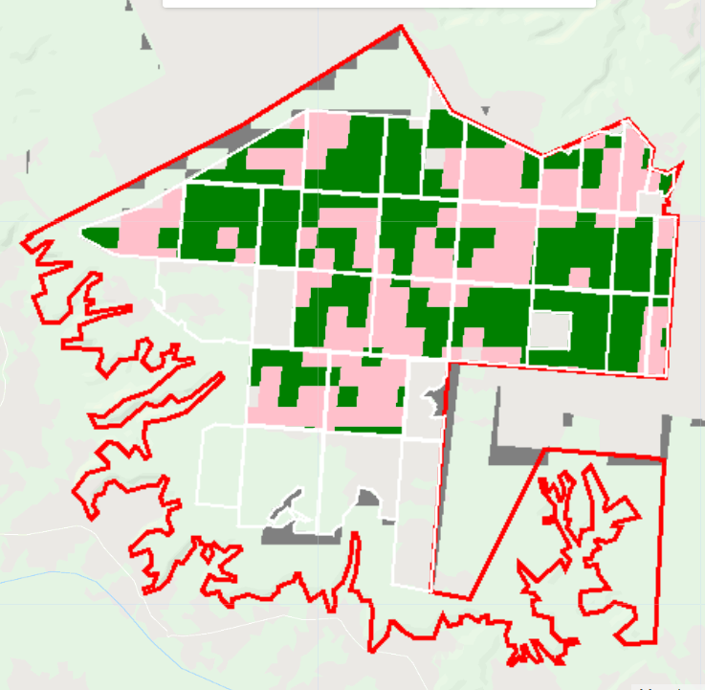
Land classification accuracy for poly1 (Piaui)
Legend:
True SC = light green
True DC = green
False SC = pink
False DC = red
False nonsoy agri = purple
False agri (actually natural) = gray
All fields are DC
This region doesn’t contain soy training points
Soymap 1
Jake’s soymap
(Jake’s soymap doesn’t have 2018)
GEE file: LandCover/Planet Do Validation

Slide 6
SC vs DC accuracy: normalized by area of SC + DC in validation data
Conclusion: it’s better for SC vs DC accuracy to pool years, even where there isn’t training data
 |  | Jake’s soymap | Soymap 1 | Soymap 2 (later)
Training points |  | Soy_pts_agsat_1 (MT only) | Soy_pts_agsat_1 (MT only), masked with map3 agri | Soy_pts_agsat_1 (MT only), masked with map3 agri PLUS PLOS pts (MT only)
Year pooling |  | Each year has separate trained classifier | 2004-2017 points are pooled and are applied to 2004 – 2018; 2003 is trained and applied by itself
Input data |  | MODIS, Landsat | Same as Jake’s soymap
Post classification masking |  | Map2.3 | Map3
Poly1 (Piaui) | True SC | n/a | 0
 | True DC | n/a | 0.56
 | False SC | n/a | 0.39
 | False DC | n/a | 0
Poly3 (Bahia) | True SC | 0.03 | 0.23
 | True DC | 0 | 0
 | False SC | 0 | 0
 | False DC | 0.94 | 0.39
Poly5 (MT) | True SC | 0.007 | 0.003
 | True DC | 0.55 | 0.71
 | False SC | 0.18 | 0.14
 | False DC | 0.015 | 0.02
GEE file: LandCover/Planet Do Validation

Slide 7
Soy vs nonsoy agri accuracy
NOTE: assumed that all fields are soy; tested whether land use map classifies all fields as soy
Takeaway: made a big assumption, so it’s unclear which soy map is better
 |  | Jake’s soymap | Soymap 1 | Soymap 2 (later)
Training points |  | Soy_pts_agsat_1 (MT only) | Soy_pts_agsat_1 (MT only), masked with map3 agri | Soy_pts_agsat_1 (MT only), masked with map3 agri PLUS PLOS pts (MT only)
Year pooling |  | Each year has separate trained classifier | 2004-2017 points are pooled and are applied to 2004 – 2018; 2003 is trained and applied by itself
Input data |  | MODIS, Landsat | Same as Jake’s soymap
Post classification masking |  | Map2.3 | Map3
Poly1 (Piaui) | % fields correctly classed as soy | n/a | 95
 | % fields incorrectly classed as nonsoy agri | n/a | 0
Poly3 (Bahia) | % fields correctly classed as soy | 97 | 62
 | % fields incorrectly classed as nonsoy agri | 3 | 35
Poly5 (MT) | % fields correctly classed as soy | 76 | 88
 | % fields incorrectly classed as nonsoy agri | 1 | 0.35
GEE file: LandCover/Planet Do Validation

Slide 8
Agri vs natural accuracy
Takeaway: unclear which soymap is better, but agri vs natural veg accuracy isn’t a huge concern
 |  | Jake’s soymap | Soymap 1 | Soymap 2 (later)
Training points |  | Soy_pts_agsat_1 (MT only) | Soy_pts_agsat_1 (MT only), masked with map3 agri | Soy_pts_agsat_1 (MT only), masked with map3 agri PLUS PLOS pts (MT only)
Year pooling |  | Each year has separate trained classifier | 2004-2017 points are pooled and are applied to 2004 – 2018; 2003 is trained and applied by itself
Input data |  | MODIS, Landsat | Same as Jake’s soymap
Post classification masking |  | Map2.3 | Map3
Poly1 (Piaui) | (area natural veg classed as agri)/(total area area)*100 | n/a | 0.16
Poly3 (Bahia) | (area natural veg classed as agri)/(total area area)*100 | 0.17 | 0.17
Poly5 (MT) | (area natural veg classed as agri)/(total area area)*100 | 3.7 | 6.3
GEE file: LandCover/Planet Do Validation

Slide 9
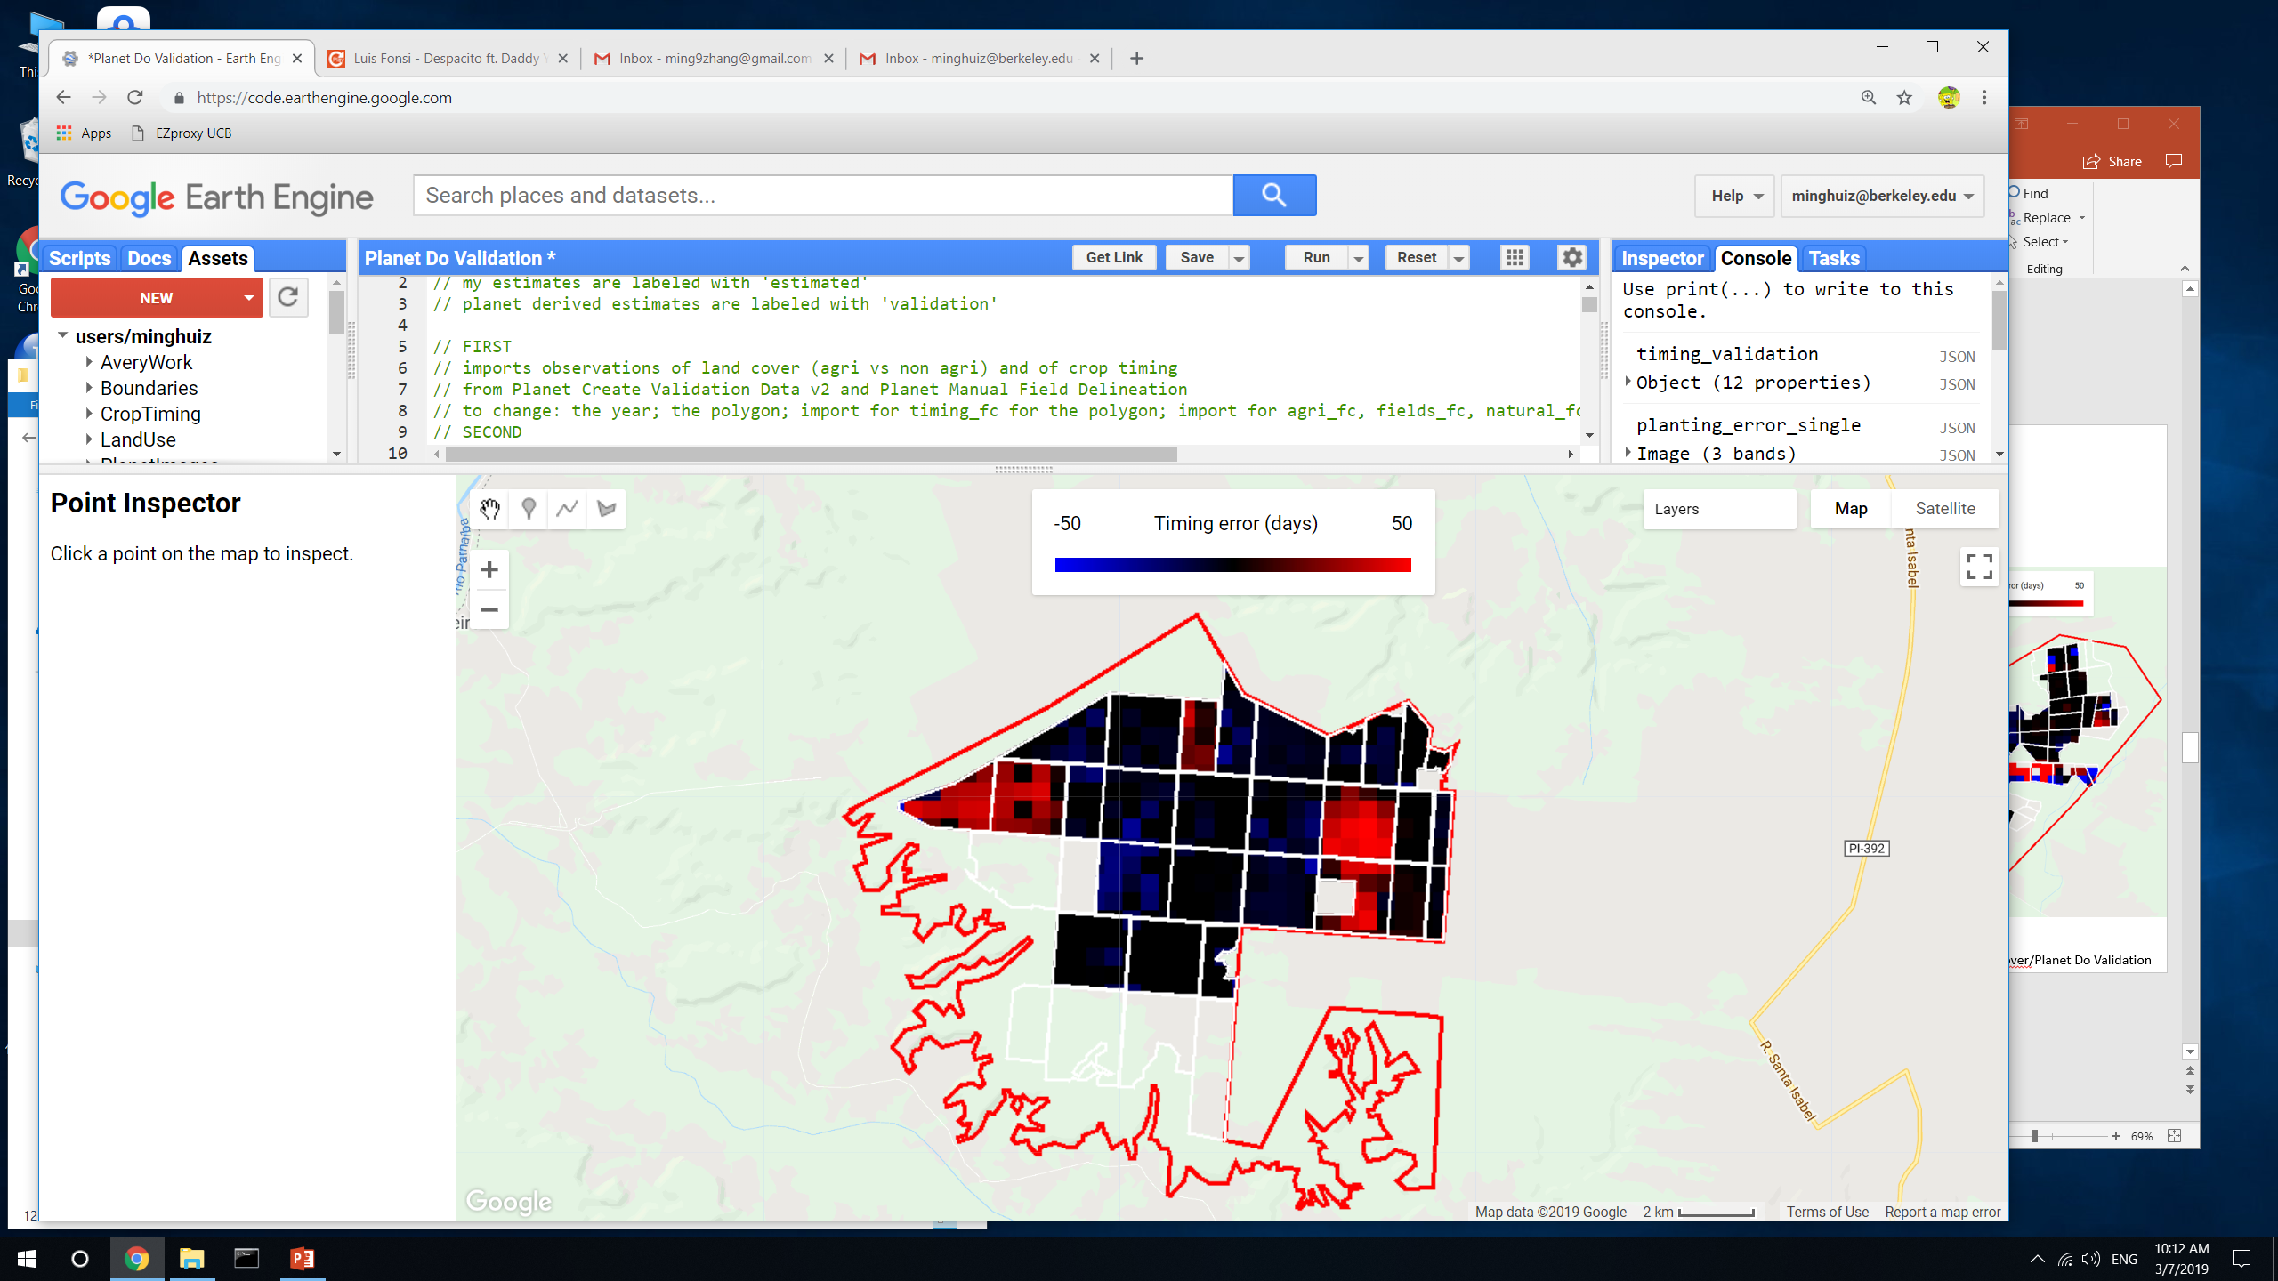
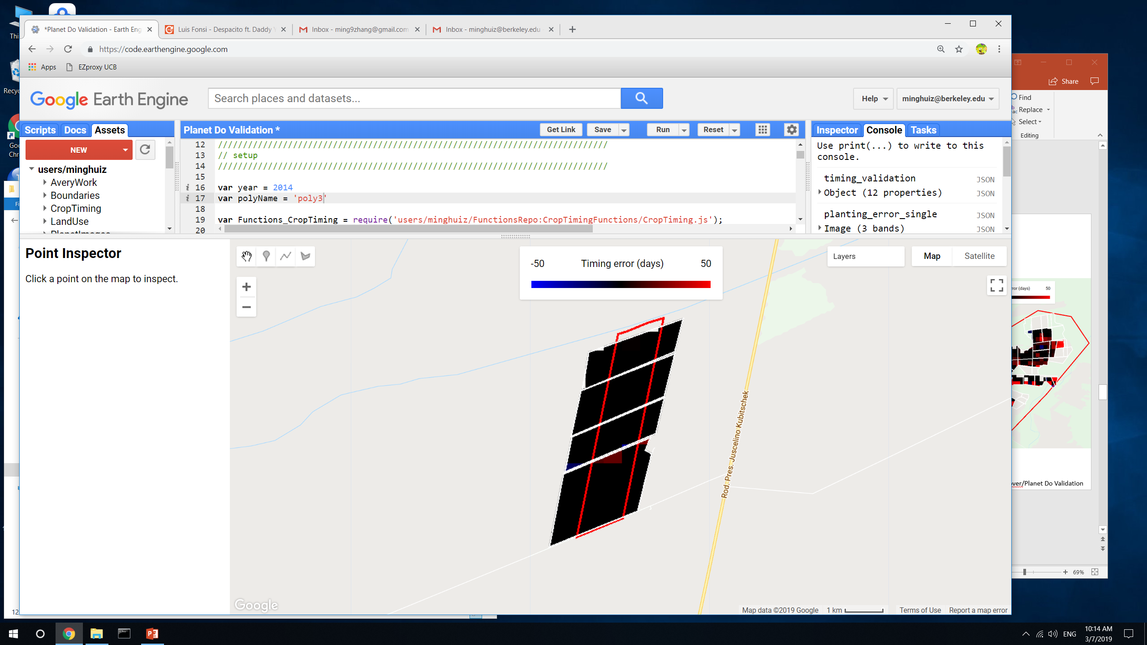
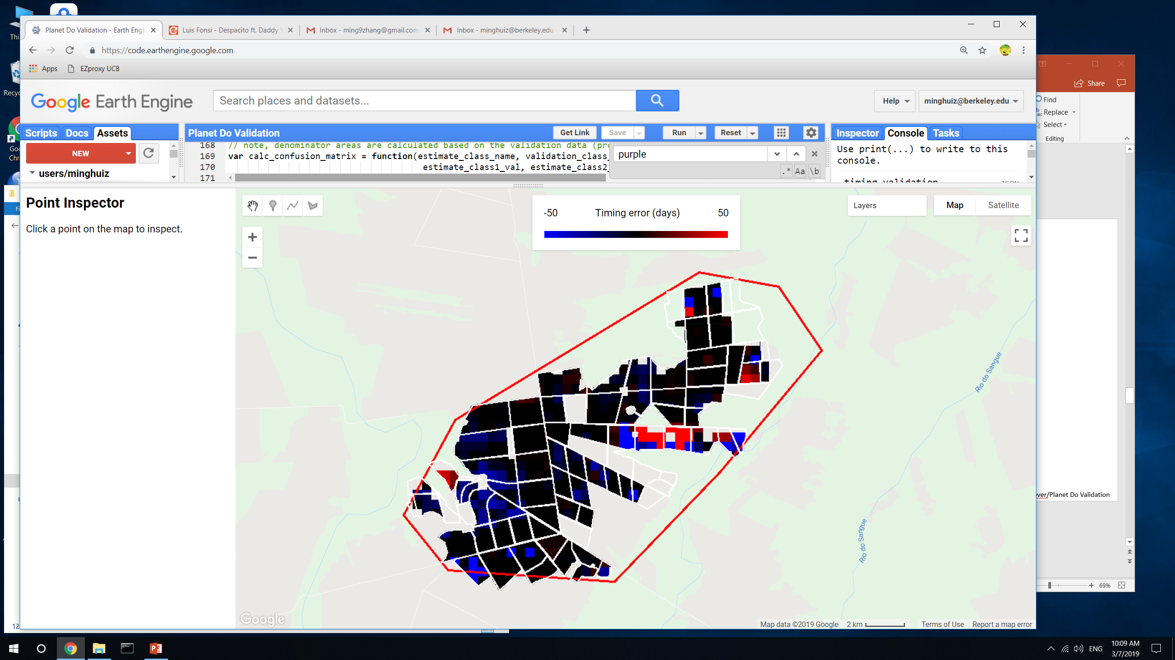
Planting (first crop) range error (days between estimate and nearest validation data point)
poly1 (Piaui)
poly3 (Bahia)
poly5 (MT)
GEE file: LandCover/Planet Do Validation

Slide 10

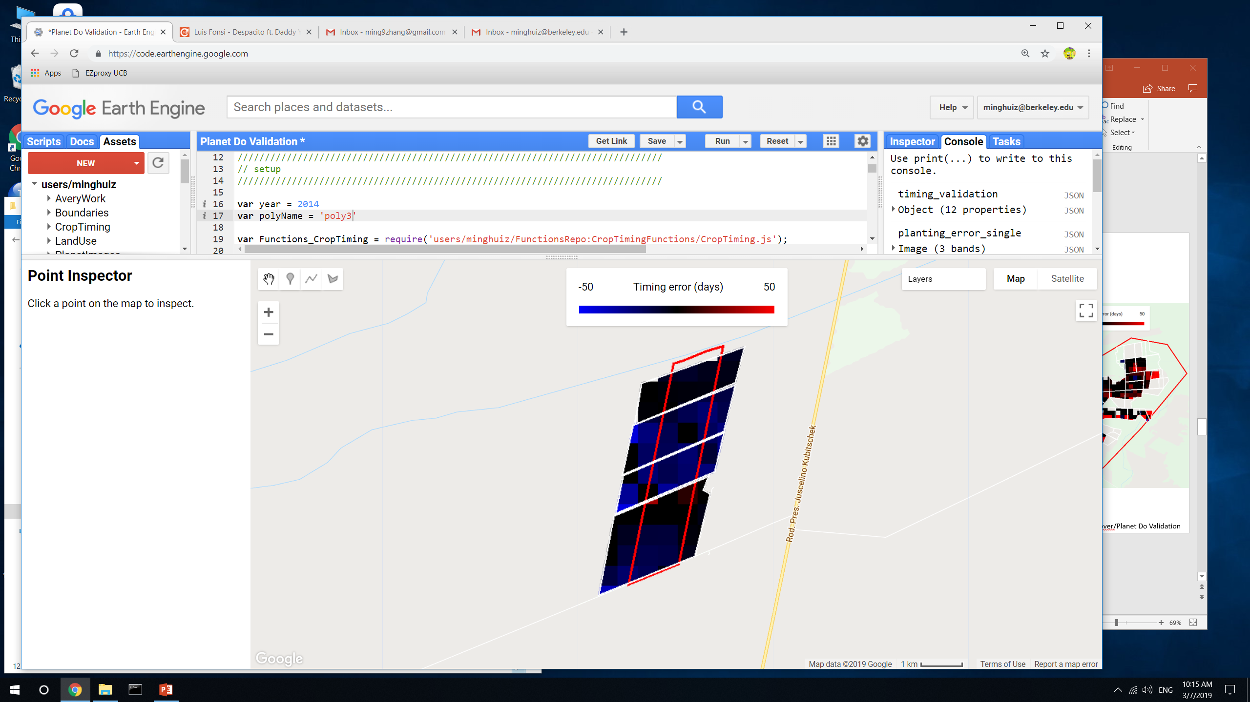
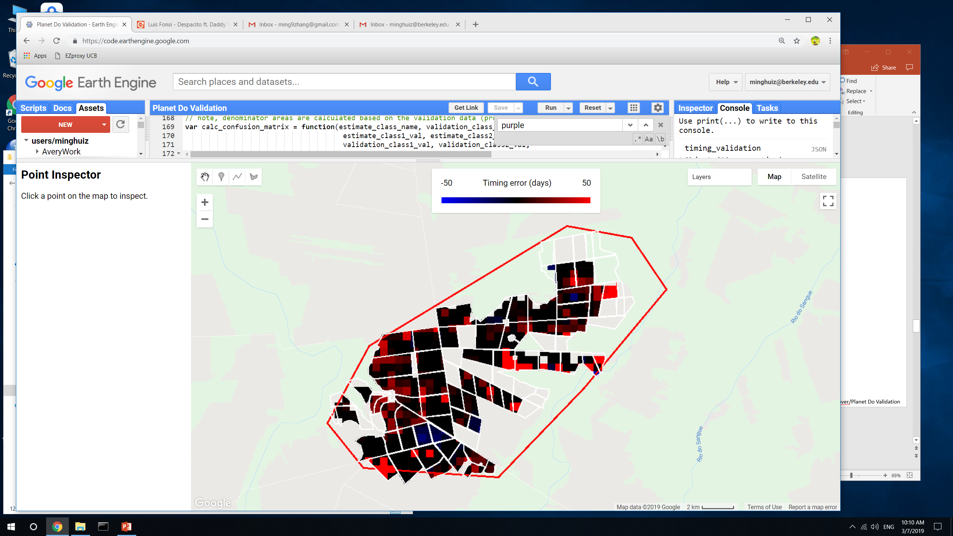
Harvest (first crop) range error (days between estimate and nearest validation data point)
poly1 (Piaui)
poly3 (Bahia)
poly5 (MT)
GEE file: LandCover/Planet Do Validation

Slide 11
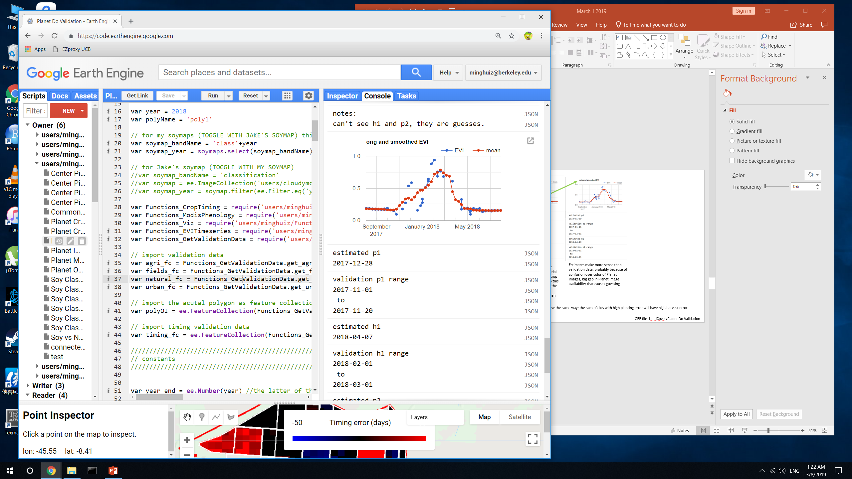
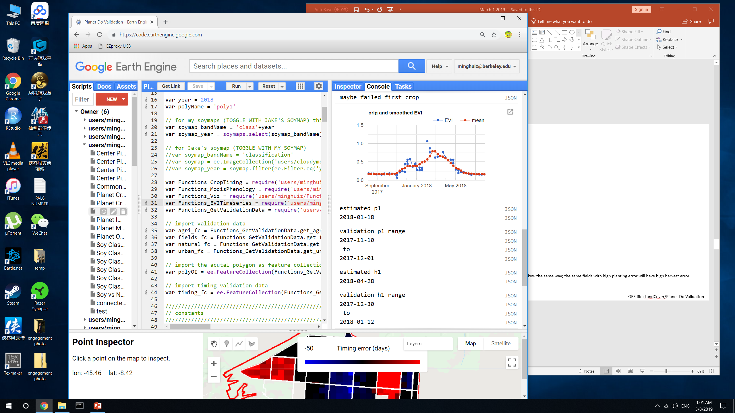
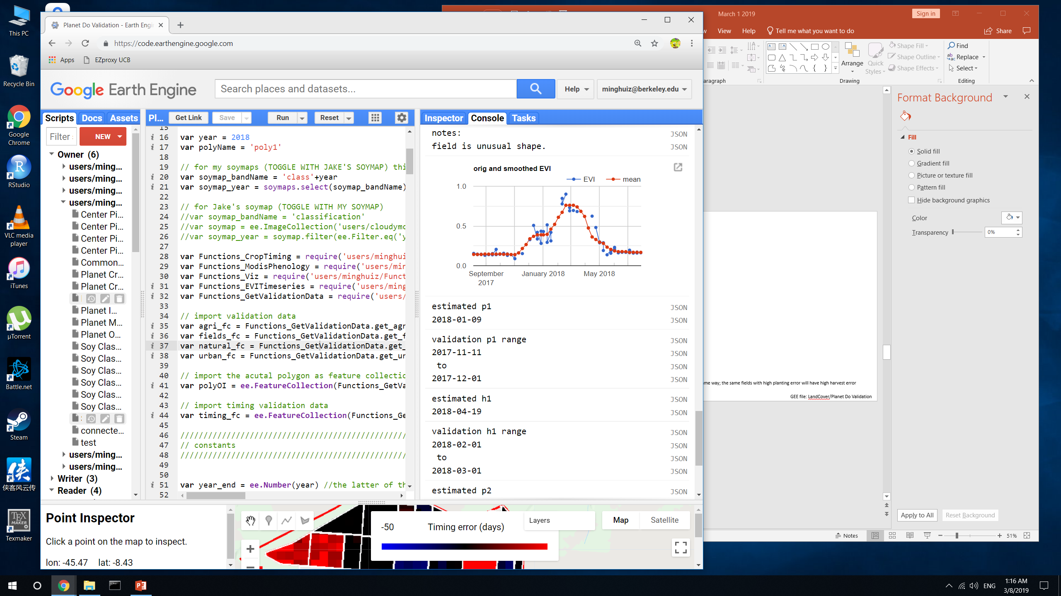
Crop timing examples
poly1 (Piaui)
Plant 1 error
Harvest 1 error
The validation data corresponds to an impossibly short cycled crop/weed/failed first crop.
Need to streamline what I call the ‘first crop’
Estimates make more sense than validation data
Big gap in Planet image availability and confusion over color (green vs brown) -> bad validation data
Lack of Planet imagery during an important time + unfortunate guesses -> bad validation data
Validation p1 was affected by the first peak; validation h1 was a bad guess based on crop cycle + p1
Planting and harvest errors skew the same way; the same fields with high planting error usually have high harvest error
When there’s a large error, it’s quite likely the validation data was bad, not the estimate
GEE file: LandCover/Planet Do Validation

Slide 12
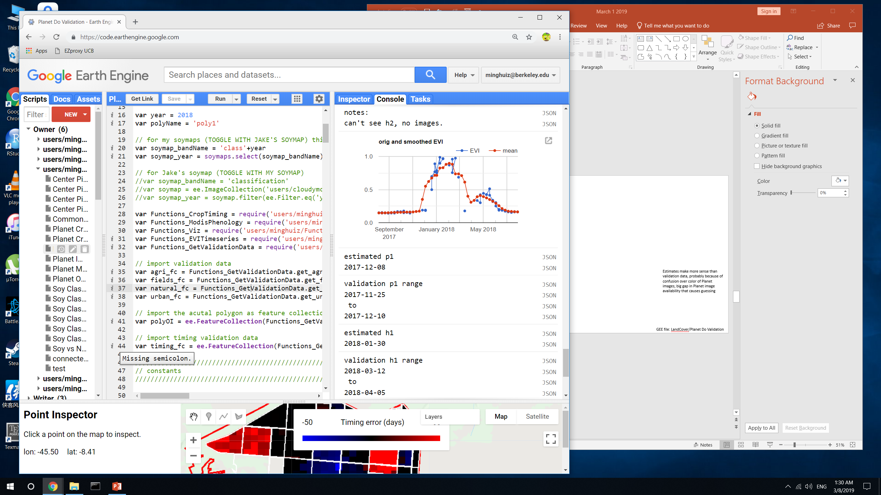
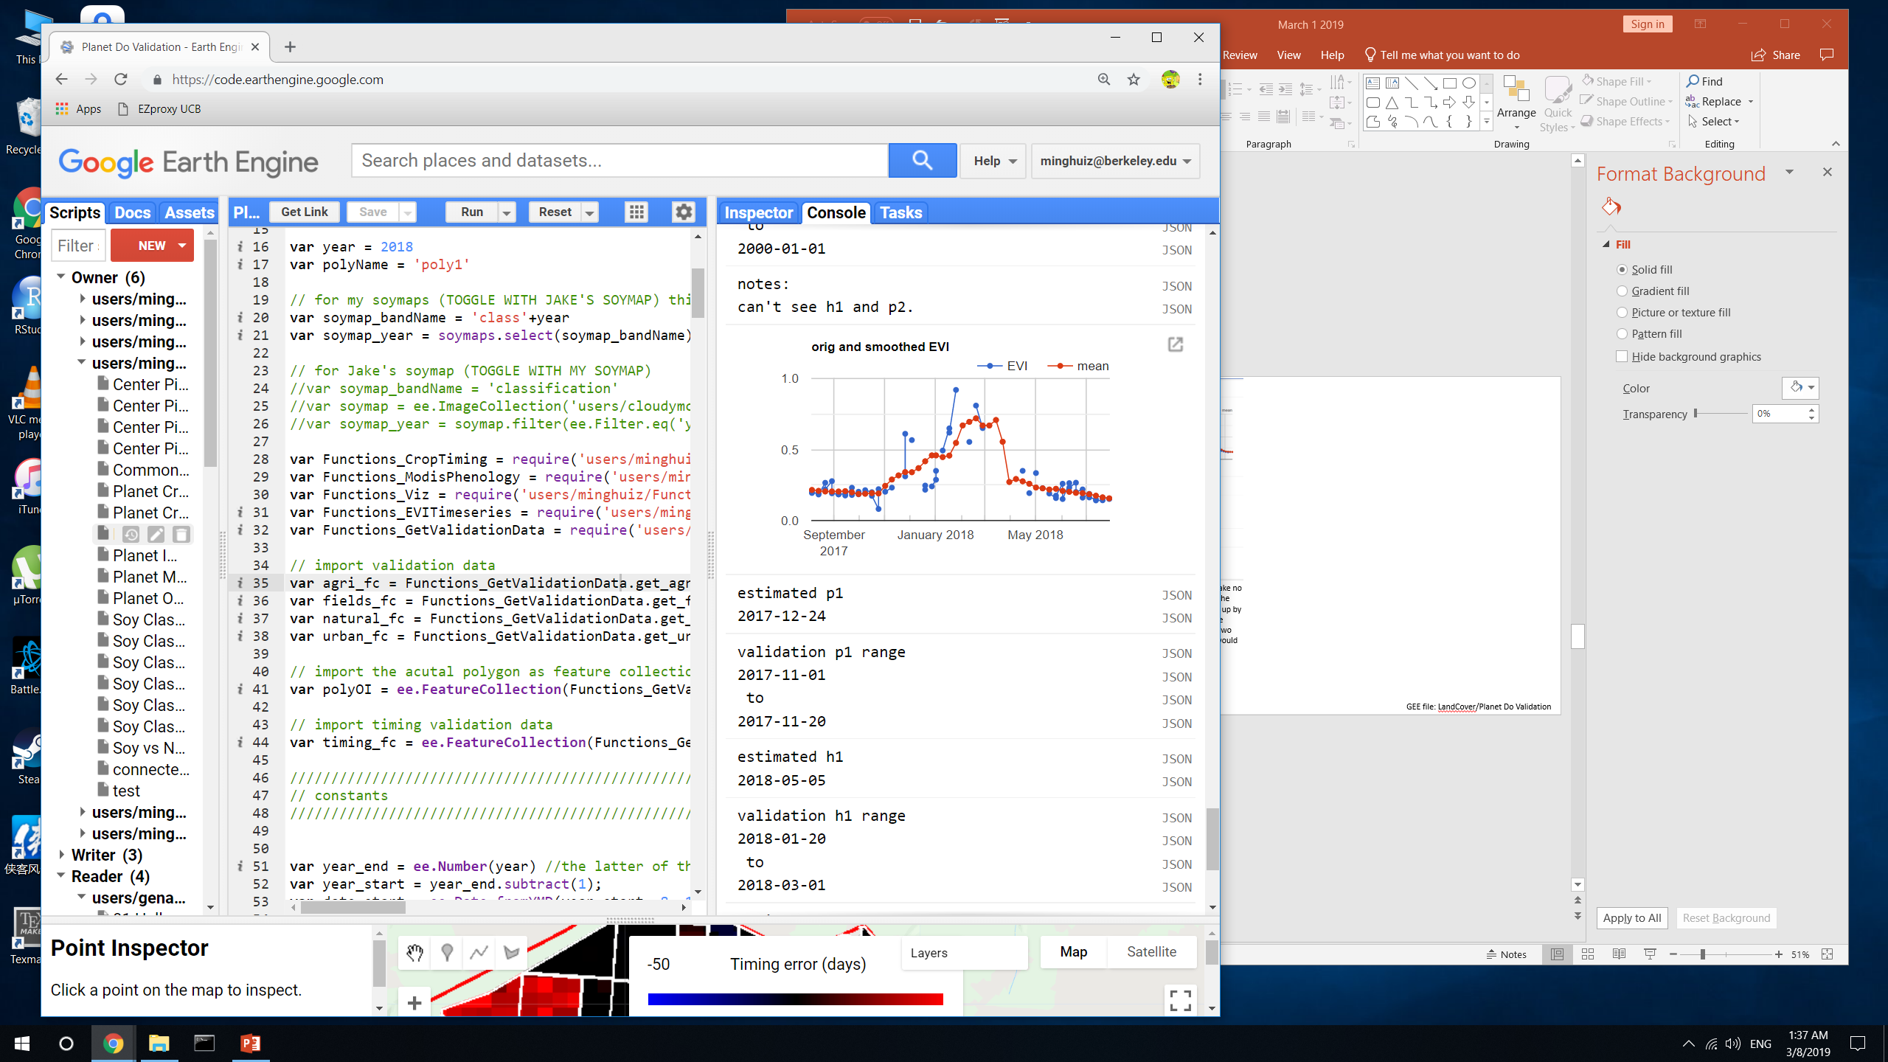
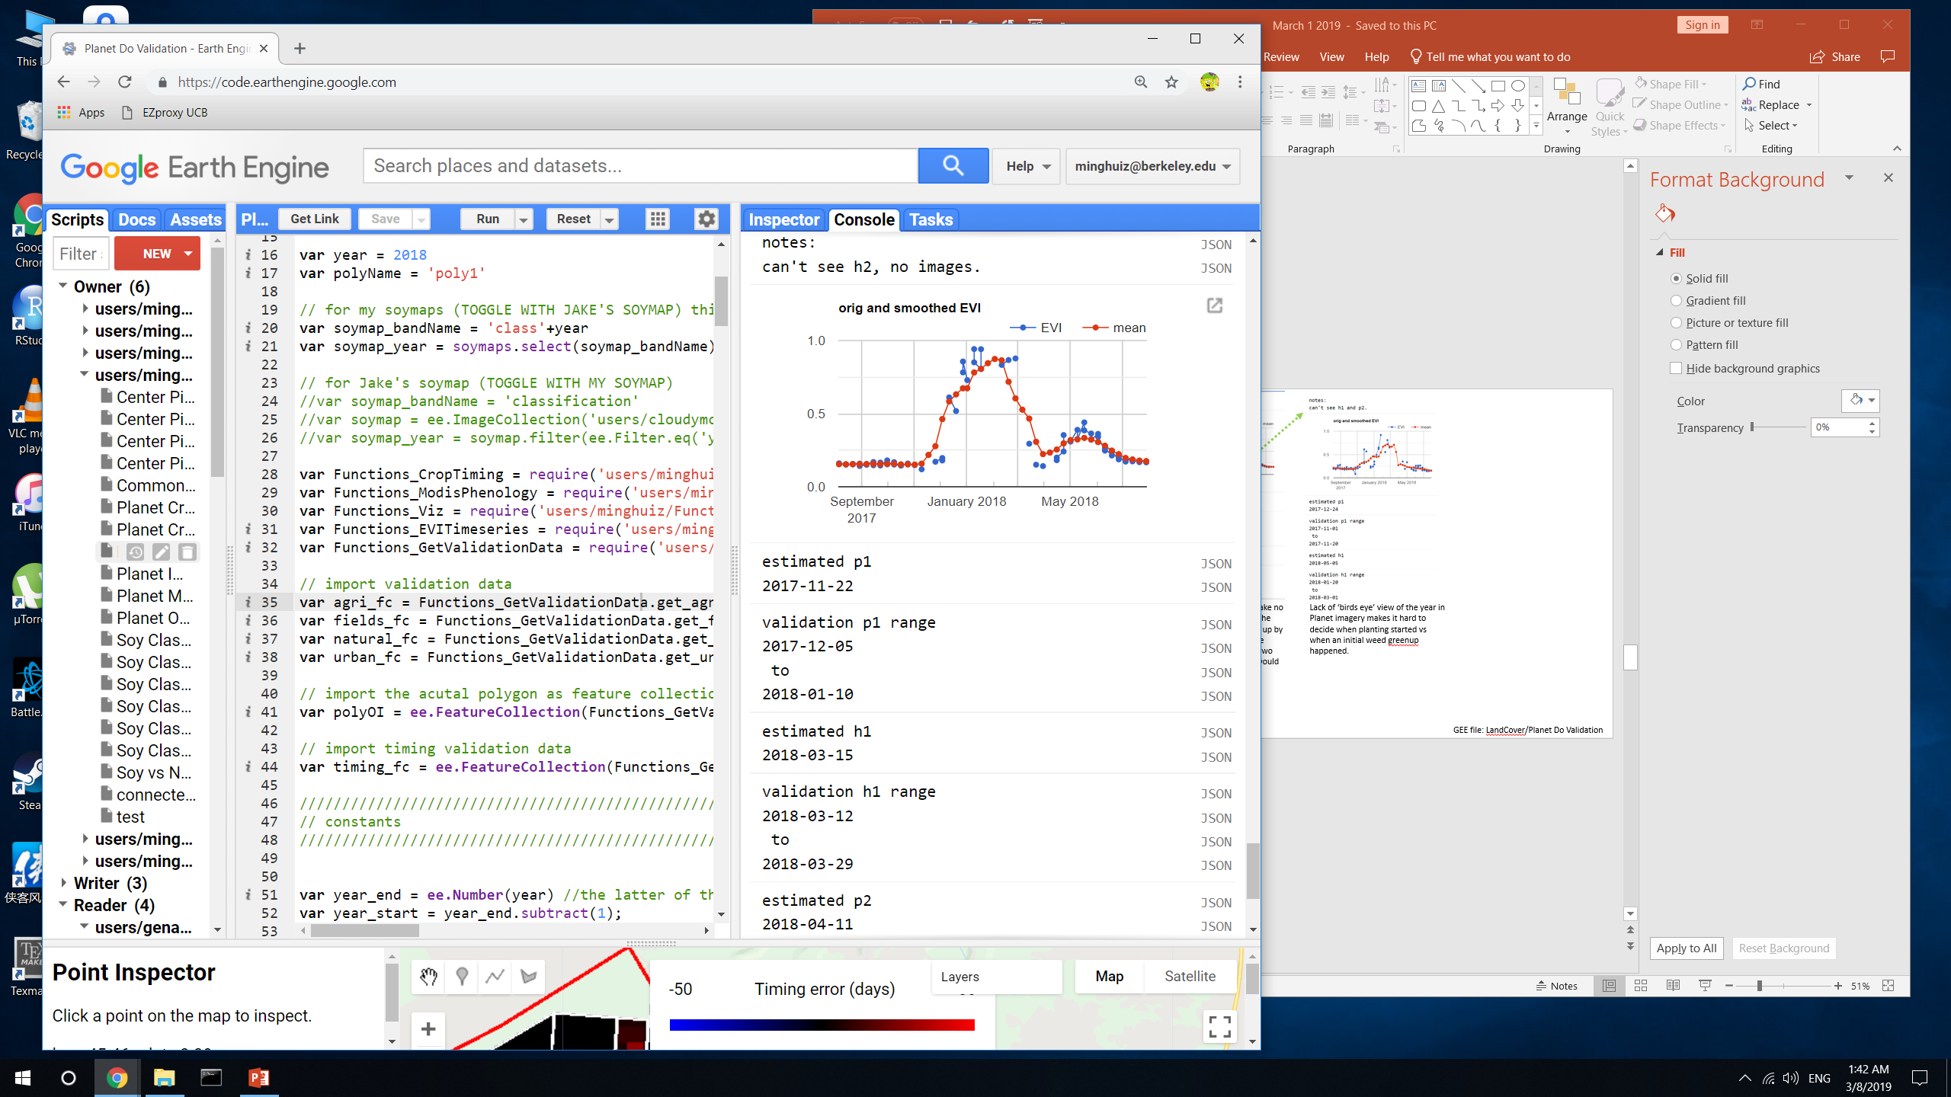
Crop timing examples
poly1 (Piaui)
Plant 1 error
Harvest 1 error
Validation p1 is late, probably because couldn’t decide if a field was ‘green’ yet
The estimates are erroneous – but this would be masked out for its 2-month crop cycle.
h1 happens at the peak EVI. The confidence of h1 is high (only two week interval) – so this error would be picked up
Need a ‘birds eye’ view of the year in addition to Planet imagery to decide when planting started vs when an initial weed greenup happened.
When the estimated dates are truly erroneous, they would have been masked out for their unreasonable crop cycles
GEE file: LandCover/Planet Do Validation

Slide 13
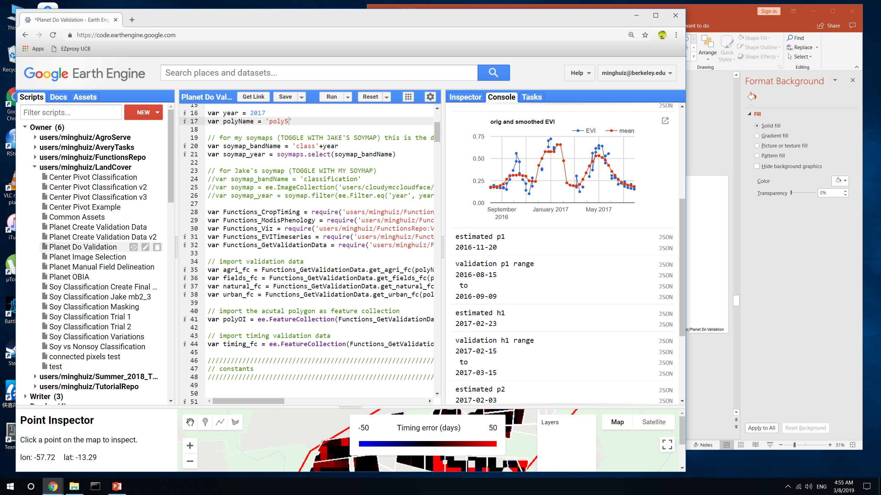
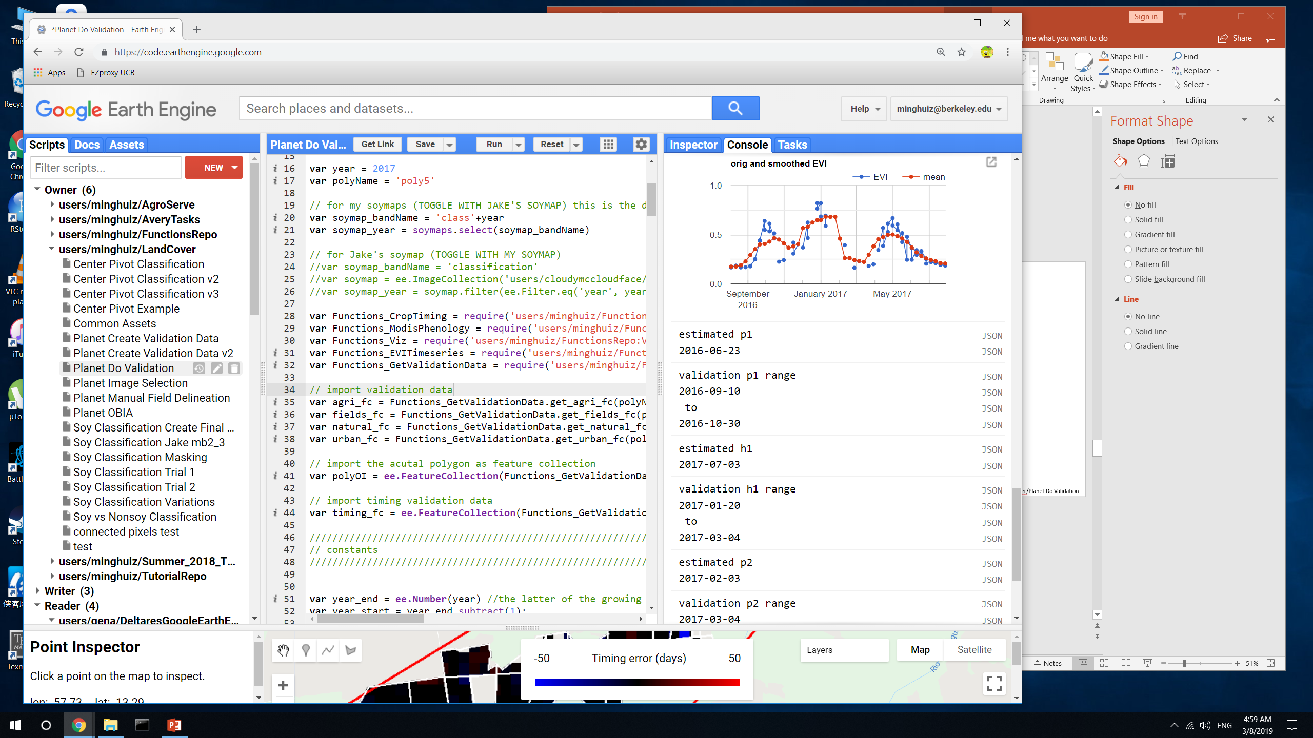
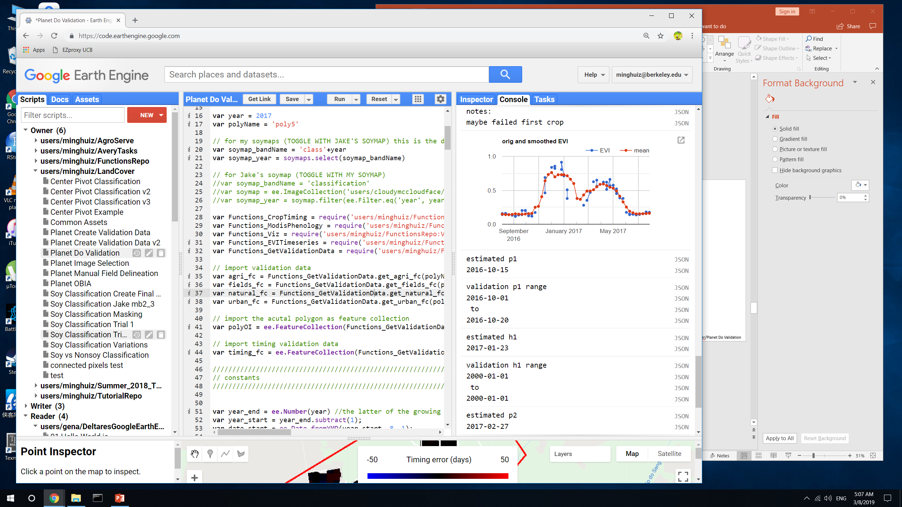
Crop timing examples
Poly5 (MT)
Plant 1 error
Harvest 1 error
Planet didn’t show triple cropping, created error in validation data.
In validation data, p1 is for first crop and h1 is for second crop
Estimation lumped the all three crops as a single crop cycle.
The resulting crop cycle is more than one year long and would be taken out in final timing map.
Example of something that worked well for both the estimate and validation data
The two TC pixels have the same error, but for different reasons: either the validation data or the estimated timing was wrong.
To generate SC/DC/TC data, need MODIS timeseries in addition to Planet images
GEE file: LandCover/Planet Do Validation

Slide 14
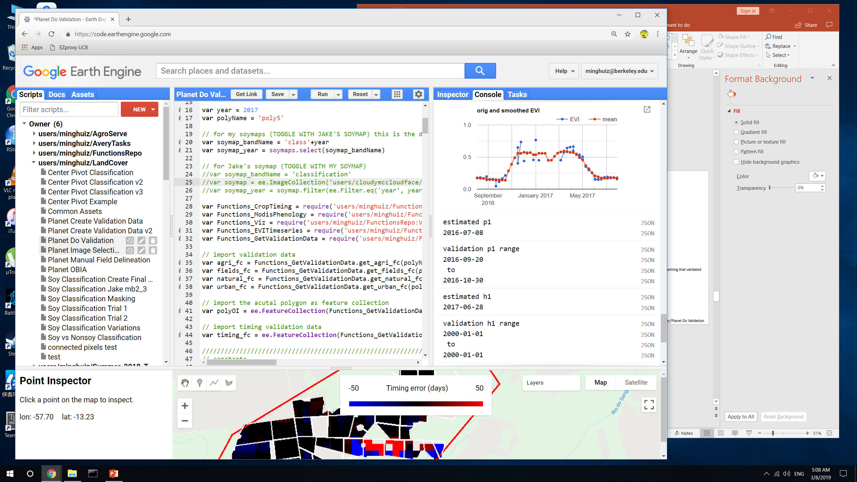
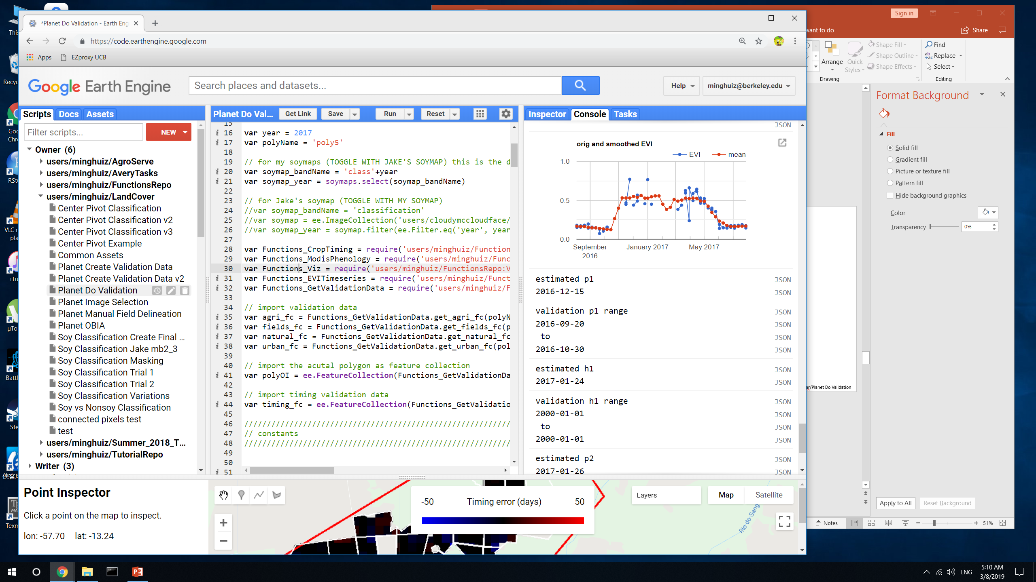
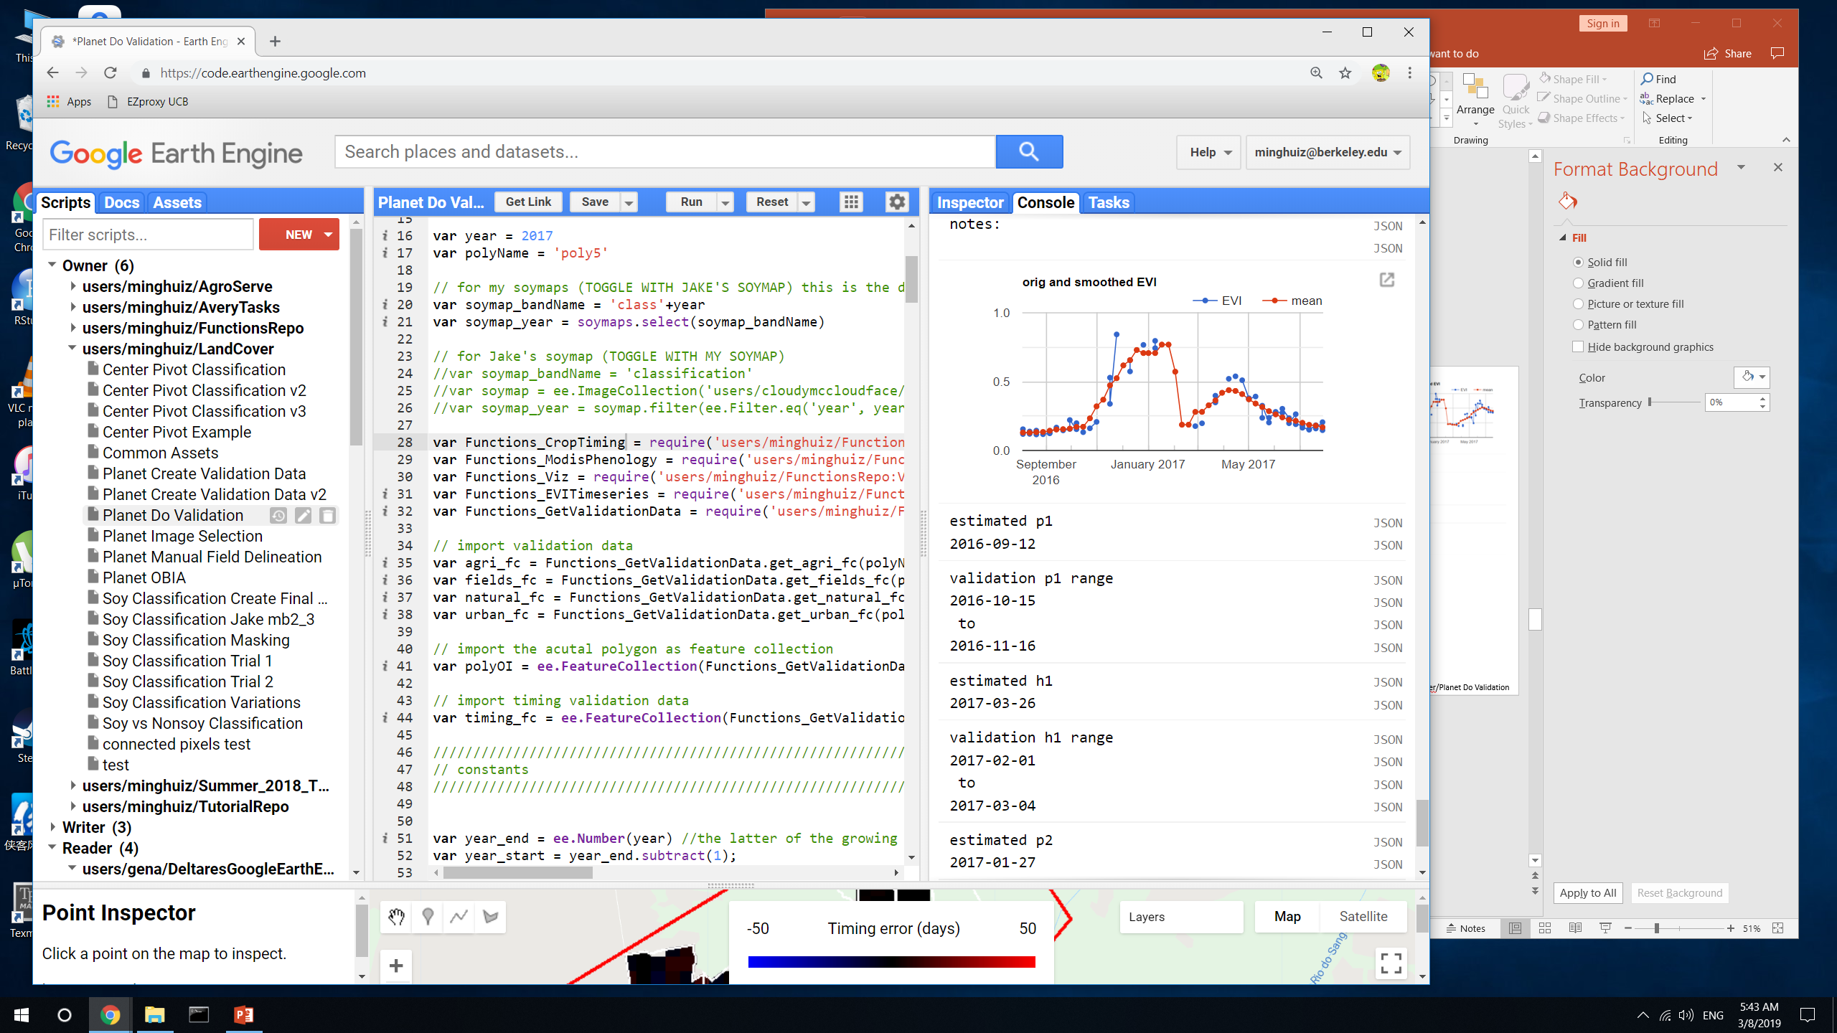
Crop timing examples
Poly5 (MT)
Plant 1 error
Harvest 1 error
Estimate would be masked out due to long crop cycle
Pixel was double cropped, but the middle dip was smoothed out in the estimate.
Estimate would be masked out due to short crop cycle
Validation h1 makes more sense than estimated h1. At 6.5 months, this would probably be masked out based on crop cycle length.
Errors in estimate can vary widely for a similar timeseries (in the same field), but they can be masked out based on crop cycle
GEE file: LandCover/Planet Do Validation

Slide 15
Takeaways
Land cover
Jake’s method doesn’t separate SC/DC as well as my soymap in both MT and Matopiba
Jake’s method seems to do better with soy vs nonsoy agri separation in Matopiba, but need more validation data
Matopiba has significant SC/DC separation challenges, so need more training data
The separation between agri and natural veg isn’t a big issue
Crop timing
Accuracy of crop timing estimates doesn’t directly correspond to accuracy of land use map, so land use map is more to separate SC/DC behavior, not to improve the pixel level estimates themselves
Although the timeseries analysis method does generate big errors, they would be masked out due to crop cycle.
The main issue is to clean up validation data, because some are based on guesses when there are 1.5+ month gaps in Planet imagery and sometimes atmospheric effects + sensor effects influence whether a field ‘looks green’ vs ‘bare’
Even after cleaning, the validation data for planting will have a range of 3-4 weeks; for harvest error will be 2-3 weeks.
Need to do regression on aggregated crop timing stats?
Do regression by chunks of time (e.g. months)?
Attach an error distribution to estimates?
Report greenup instead of planting date to decrease error?
Only need a few more polygons’ worth of plant/harvest validation data.
Purpose is to look for more ‘error cases’, not adjust timeseries analysis method.
Error is unlikely to get smaller, even with highest possible quality validation data.
GEE file: LandCover/Planet Do Validation

Slide 16
Next
Crop timing
Clean + mask validation data to create ‘high confidence’ dataset
Mask out validation data that doesn’t match up with MODIS timeseries
Mask out validation data based on the width (in days) of the validation range, which is the current proxy for confidence level
Attach a ‘confidence level tag’ when generating new validation data
Clean + mask crop timing estimates based on crop cycle + peak timing
Attach error distributions to crop timing estimates
At pixel and field/aggregated scale
Based on width of validation range and ‘range error’
Do all pixels/cells have the same error?
Separate errors for p1, (h1 + p2), and h2 (due to likelihood of clouds impacting TS analysis)
Create SC/DC training and validation data
Delineate fields from Planet images in Matopiba and Mato Grosso
Look at MODIS EVI timeseries over these fields, in addition to Planet images, to determine crop intensity
Download Planet images over wider area, fewer dates.
Given the wide range of soy, soy-corn, weed/starter crop-soy-corn timing, it probably doesn’t matter much whether we are sure a crop is soy.
Create field scale SC/DC/TC data
Use as training points for soymap
Create soy vs nonsoy agri training and validation data
Separate MT training points as soy, nonsoy agri (PLOS points have specific nonsoy crops)
Look for spectral, phenological and visual differences among crops
Create training data
New soymaps
Use PLOS training data + previous soy_pts_agsat_1 training data
Center pivot

